Slide 1
Project NLP and Fine-tuning
Group 3
Joshua Lopez, Alex Castillo, Edward Cruz, Gerardo Gonzalez

Slide 2
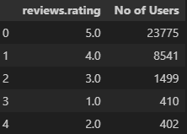
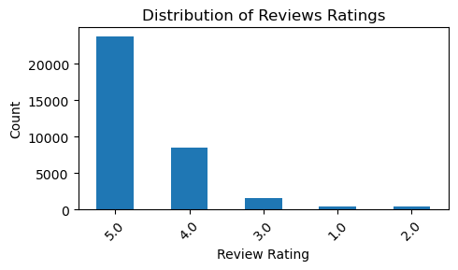
Traditional NLP & ML approaches
Dataset used: 1429_1.csv
From: https://www.Kaggle.com/datafiniti/consumer-reviews-of-amazon-products
a) Data Preprocessing
- We analyzed the dataset to determine which columns were really useful for the case.
- Check features that had null values and clean them.
- After removing columns that had most null values. By checking the distributions of the other feature, we determined that for the sentiment classifier, the most important feature are “reviews.text” (model input features) and “reviews.rating ( model target )

Slide 3
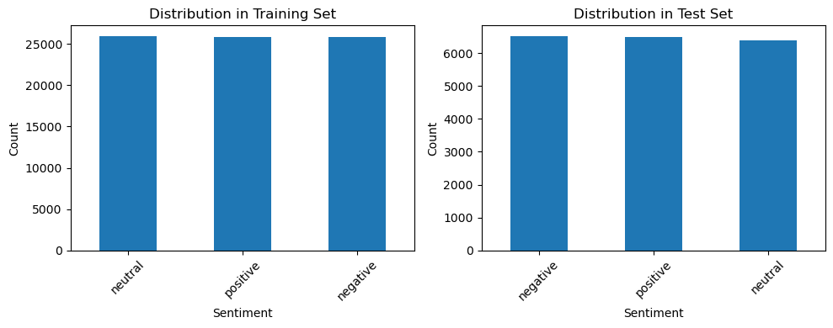
b) Clean Texts Tokenize and Remove stopwords
First split the dataset into features and target
To the input feature column (reviews.tex):
Clean stop words (NLTK)
Convert to lowercase
Remove punctuations
To the target column (reviews.rating):
creates a function to map rating to sentiments.
Positive (ratings 4-5)
Negative (ratings 1-2)
Neutral (ratings 3)
c) Vectorize text data using TF-IDF and Balancing
-Vectorize the clean reviews.text.
- I apply SMOTE on the vectorize data to balance the dataset.

Slide 4
Split data into Training and Test and Train using Different Traditional NLP and ML models

Slide 5
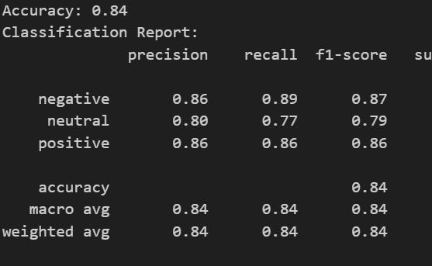
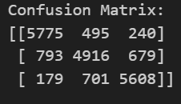
Naive Bayes

Slide 6
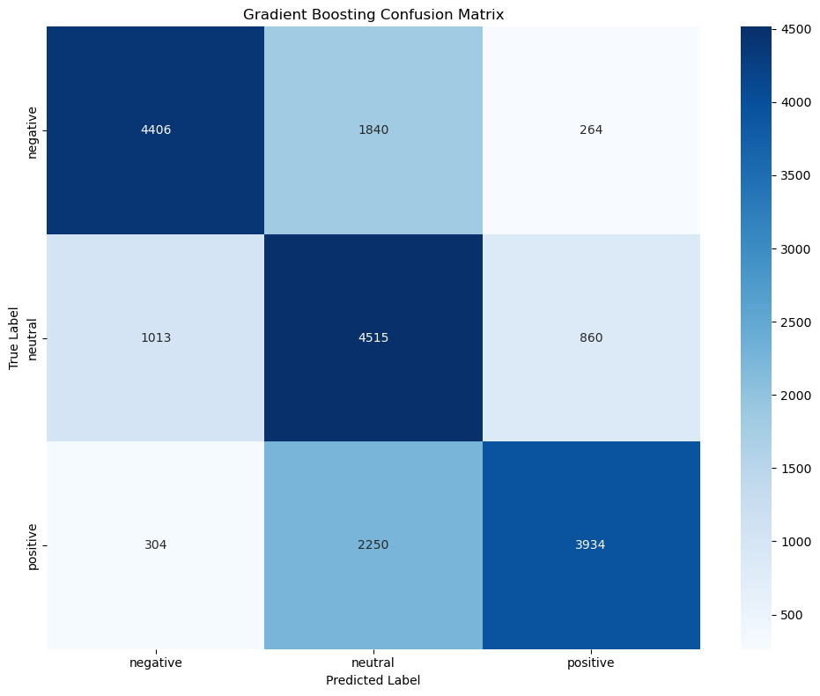
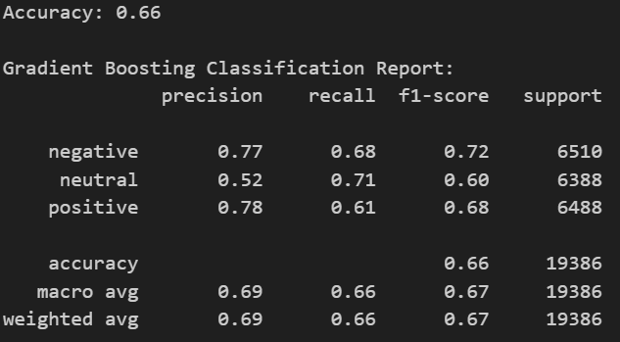
Gradient Boosting

Slide 7
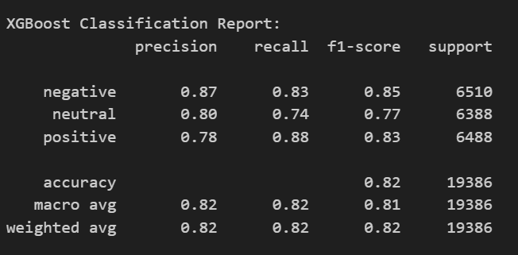
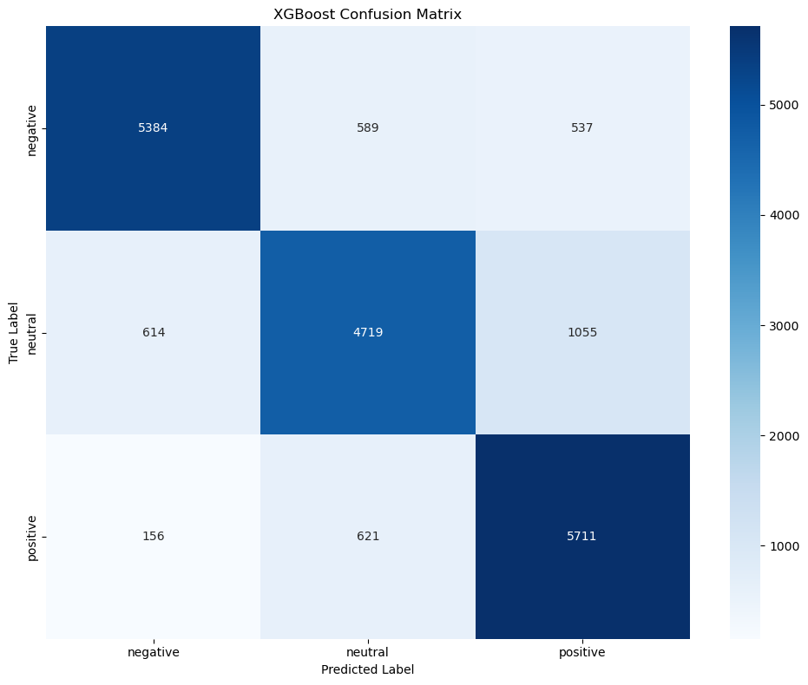
XgBOOST

Slide 8
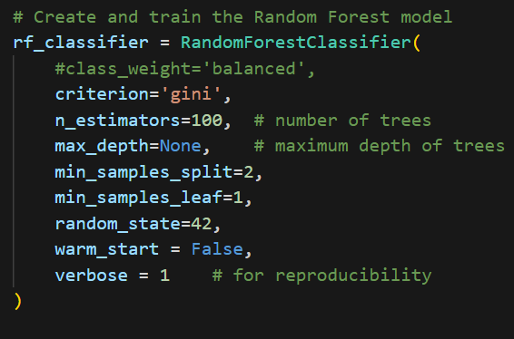
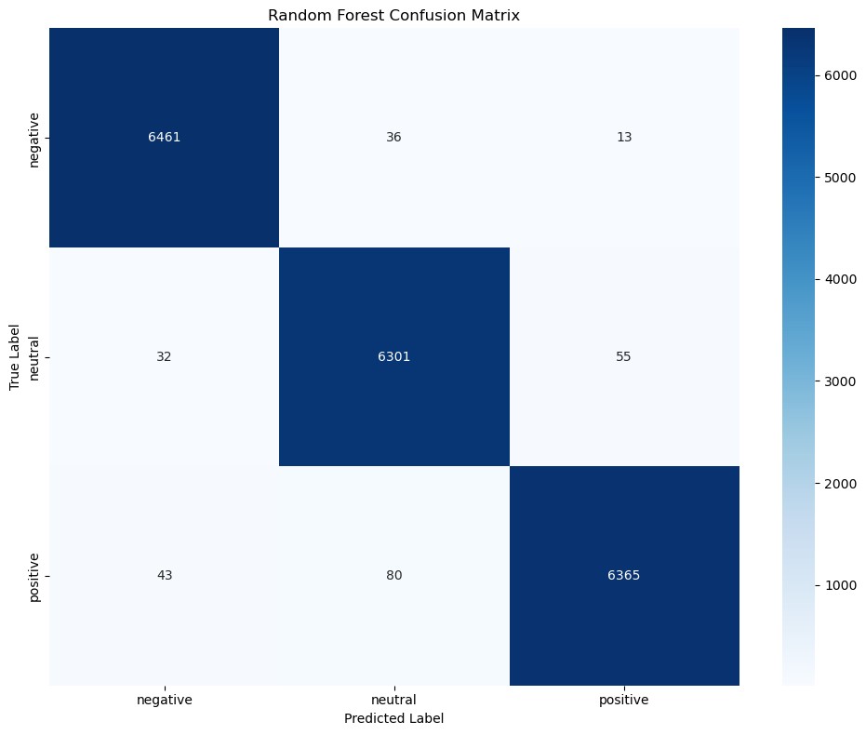
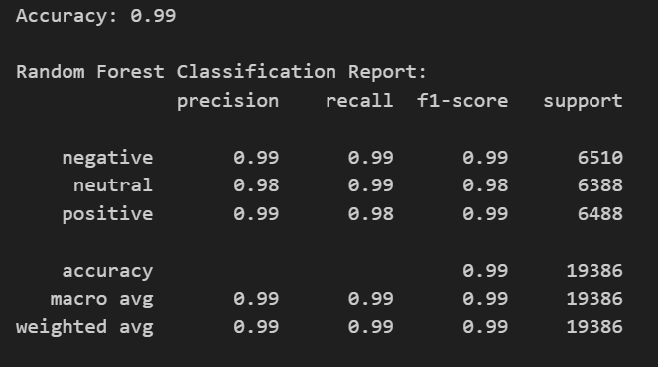
Random Forest

Slide 9

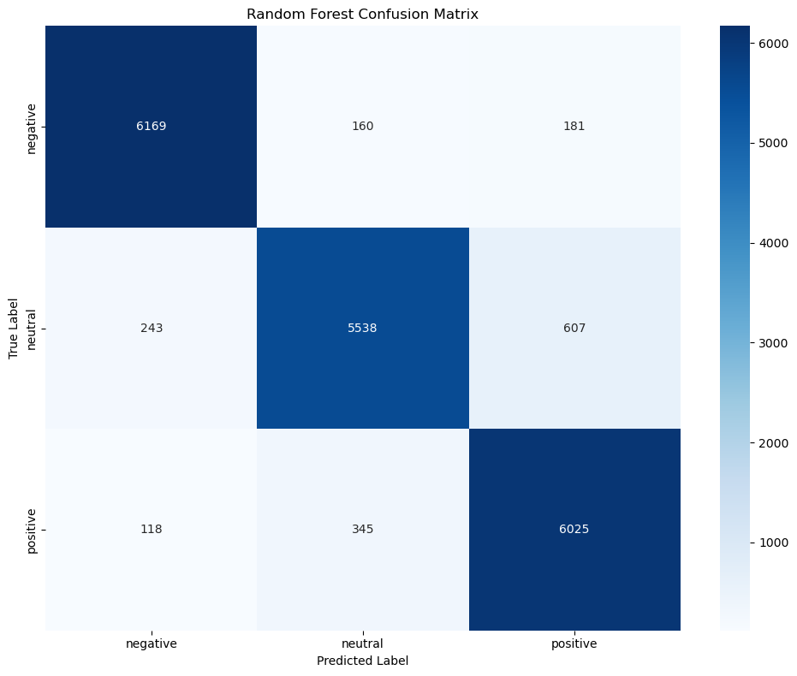
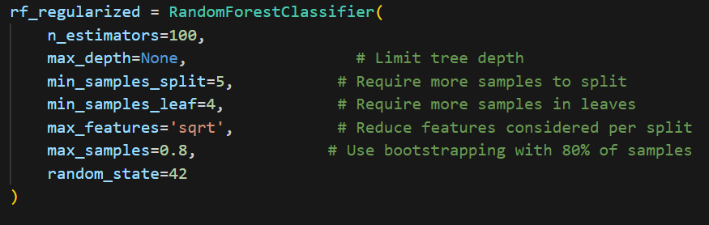
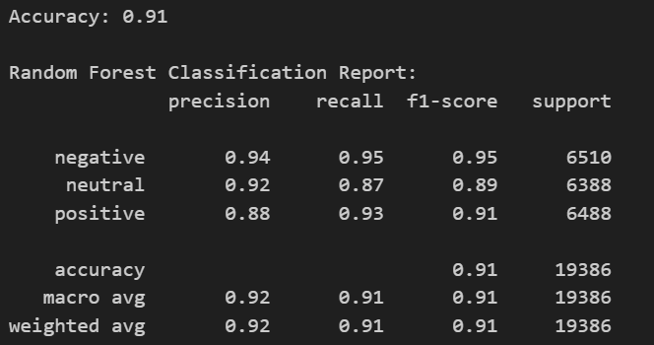
Random Forest L2 Regularize

Slide 10
Part 2: Sequence-to-Sequence modeling with LSTM
-Goal: Build a Bidirectional LSTM model to predict the review class i.e, negative, positive or neutral

Slide 11
a) I did the same data preprocessing as for the traditional NPL models:
Deleted unnecessary columns
Remove nulls
Remove stopword, punctuations.
Convert to lowercase
Word tokenize
Vectorize the data
Balance the data with SMOTE
Split data into training and validation datasets

Slide 12
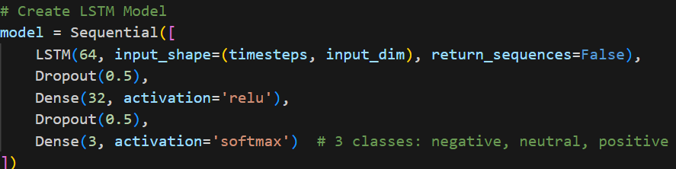
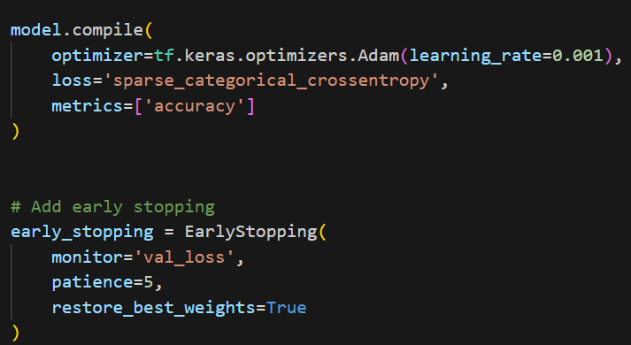
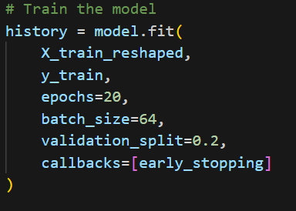
b) Train LSTM Model
-Reshape input data for LSTM (samples, timesteps, features)
Arquitecture:

Slide 13
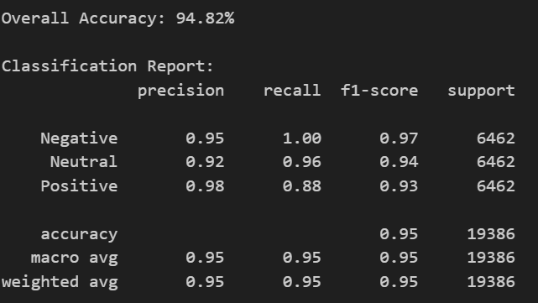
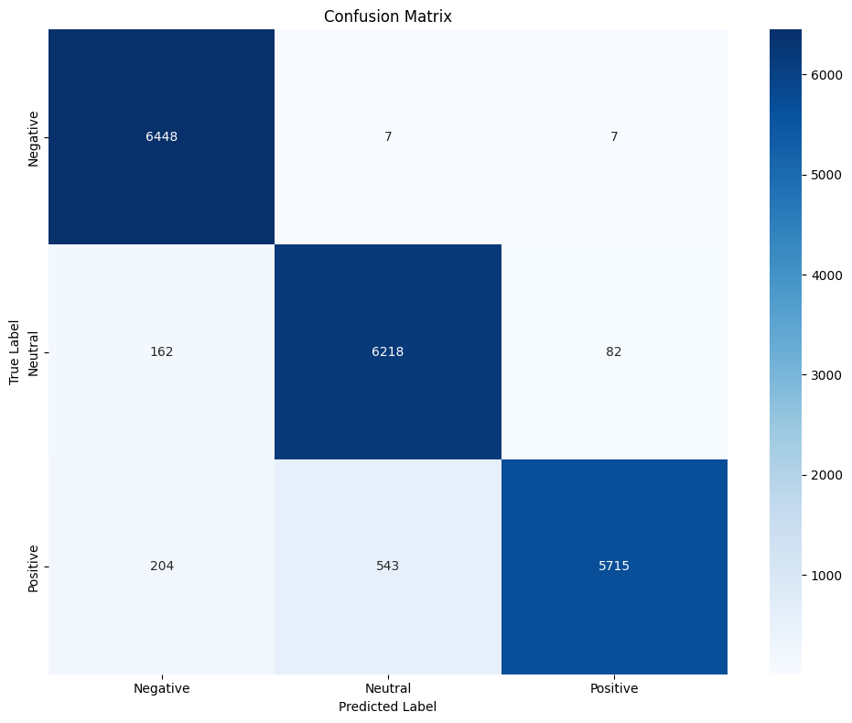
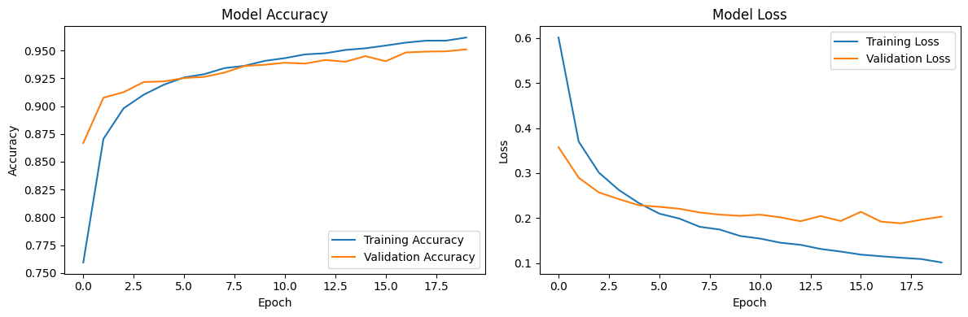
c) Evaluation
Report: Confusion Matrix: Accuracy and loss Plot:

Slide 14
3) Transformer approach (HuggingFace API)
-Goal: Model Selection
The dataset used: Datafiniti_Amazon_Consumer_Reviews_of_Amazon_Products.csv from https://www.kaggle.com/datasets/datafiniti/consumer-reviews-of-amazon-products

Slide 15
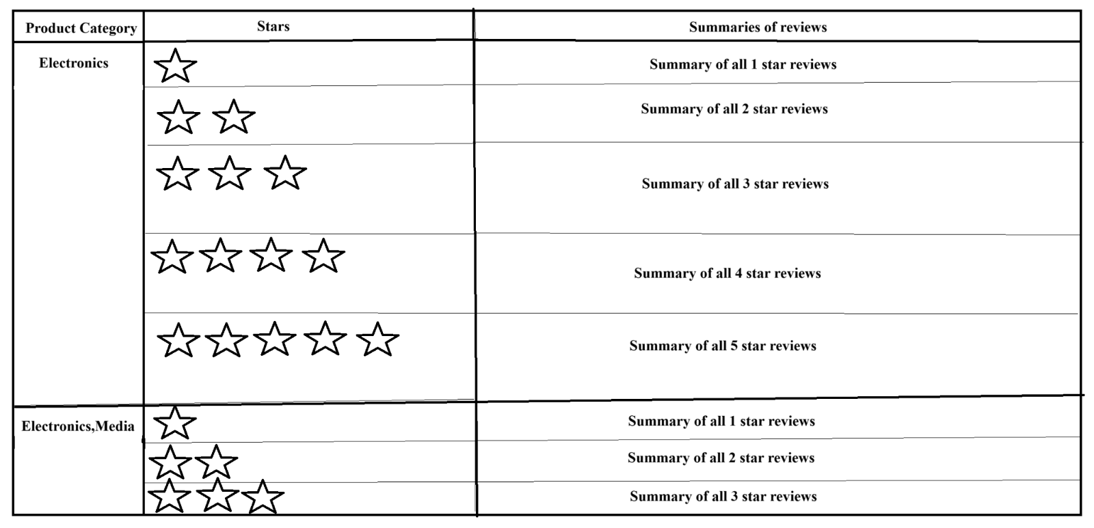
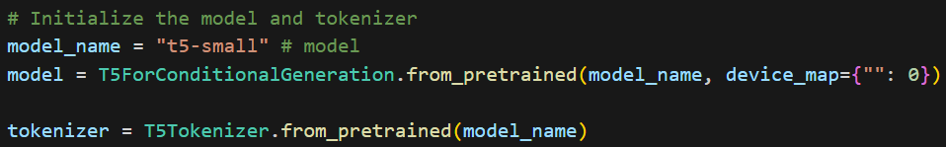
Transformer approach (HuggingFace API)
The dataset used: Datafiniti_Amazon_Consumer_Reviews_of_Amazon_Products.csv
from https://www.kaggle.com/datasets/datafiniti/consumer-reviews-of-amazon-products
The goal was to have a summary of all reviews broken down by each star or rating, for all product categories. It would look like this, where every product had, for each rating, a single summarization of all reviews combined of that rating.
The model used: t5-small from https://huggingface.co/google-t5/t5-small

Slide 16
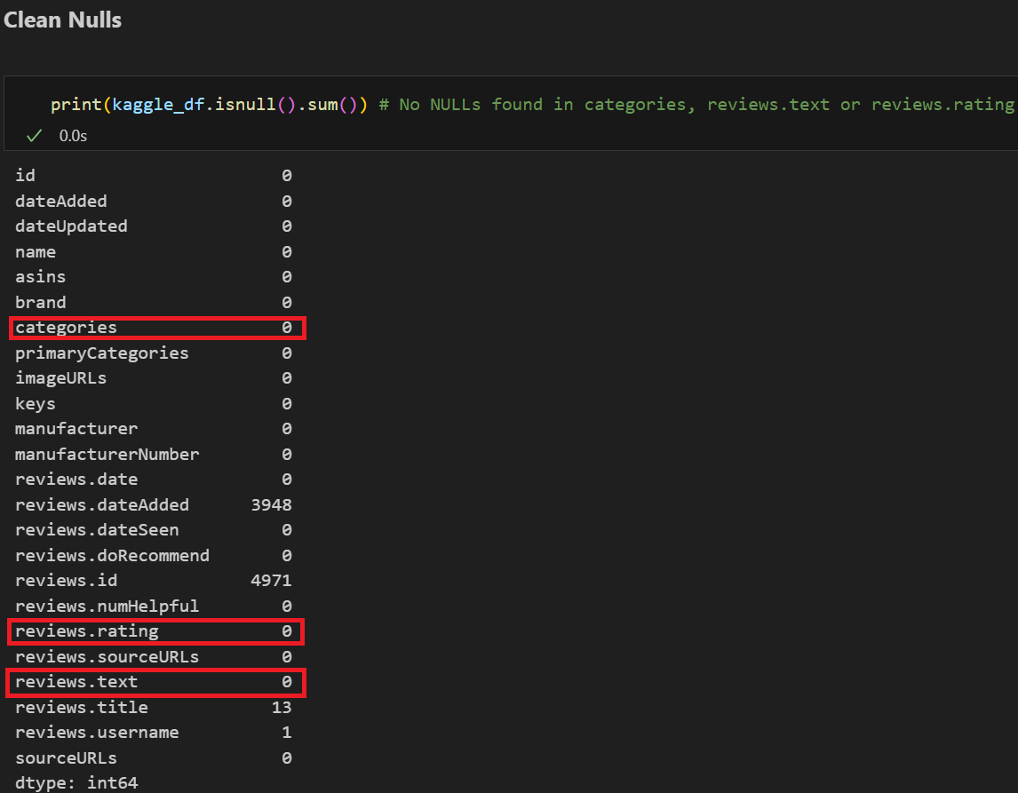
Data Preprocessing
Data Cleaning and Tokenization
Cleaning NULLS
Since the columns that were going to be used were “categories”, “review.rating” and “review.text”, and they didn’t have NULL values, eliminating the NULL fields was not needed.

Slide 17
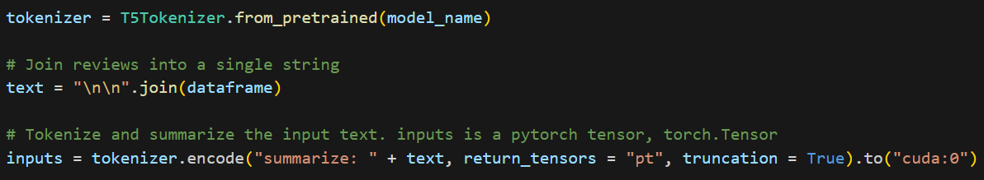
Tokenization
For the tokenization the T5 library provided an instruction to encode the data to be summarized.
Metrics:
Summarization models use ROUGE metrics instead of accuracy scores to verify how good the model is.
The ROUGE scores used were rouge1, rouge2, rougeL and rougeLsum. It is preferred to use rougeL since it uses the longest common sequence to produce its score. Since its rougeL score is 0.087, it is not a good model to use.
The scores for the pre-trained model are:
rouge1 average: 0.0873561269402484
rouge2 average: 0.0
rougeL average: 0.08728537224163033
rougeLsum average: 0.0873561269402484

Slide 18
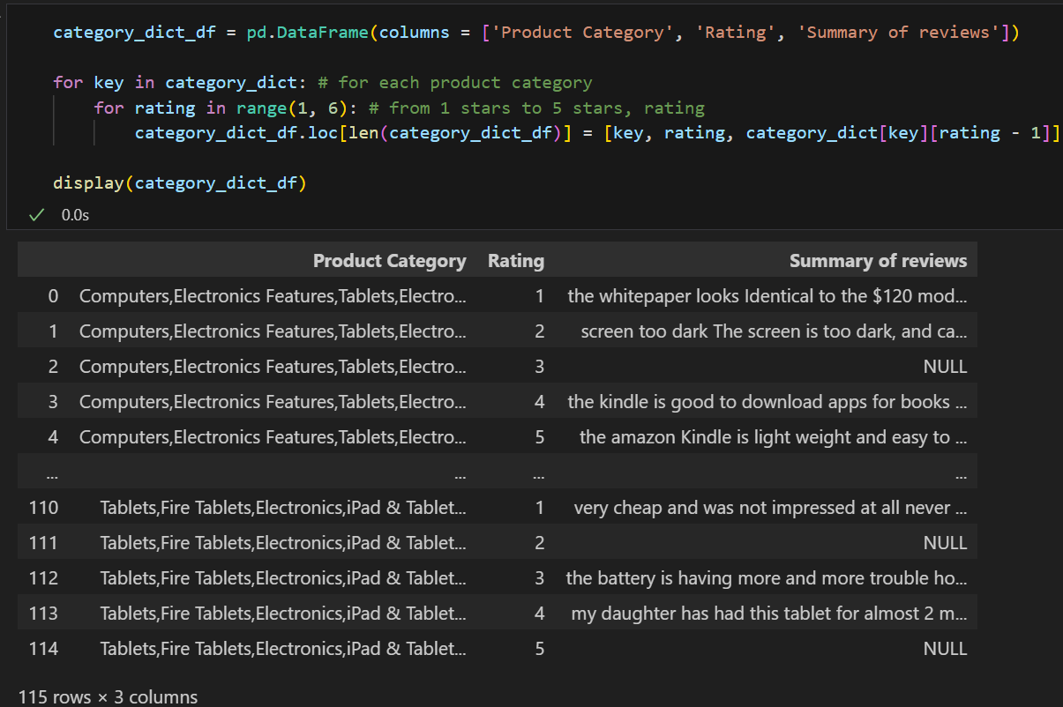
End Results:

Slide 19
Fine-Tuning (HuggingFace API)
The dataset used: 'gopalkalpande/bbc-news-summary'
from Dataset library
The model used: t5-small from https://huggingface.co/google-t5/t5-small

Slide 20
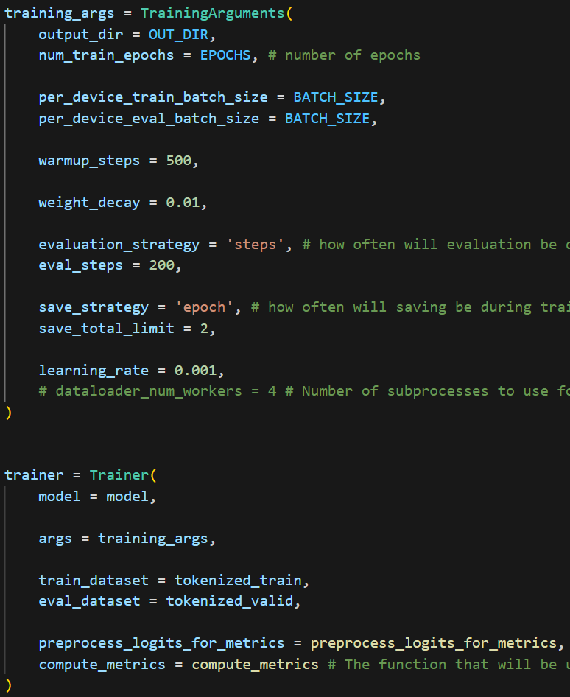
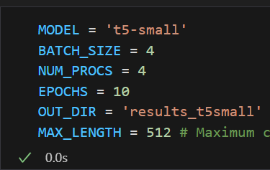
Parameters
BATCH_SIZE = 4
NUM_PROCS = 4
EPOCHS = 10
evaluation_strategy = ‘steps’
eval_steps = 200
Each 200 steps will report its ROUGE metrics.

Slide 21

Metrics
The scores for the fine-tuned model were:
rouge1: 0.0898500
rouge2: 0.828500
rougeL: 0.881800
It had 10x a better rougeL score than the previous model. So this model would be a whole lot more usable for text summarization.

Slide 22

Transformer approach (HuggingFace API)
The dataset used: 1429_1.csv
from https://www.kaggle.com/datasets/datafiniti/consumer-reviews-of-amazon-products
The goal was classify product review sentiments into Positive, neutral and negative.
Data Preporcessing:
• Clean nulls
• Drop unnecessary columns
• Remove short and super long reviews.
• Group together rating and Map them to Sentiment: Rating 1-2 = Negative,
Rating 3 = neutral and rating 4-5 = positive.
The model used: bert-base-uncased

Slide 23
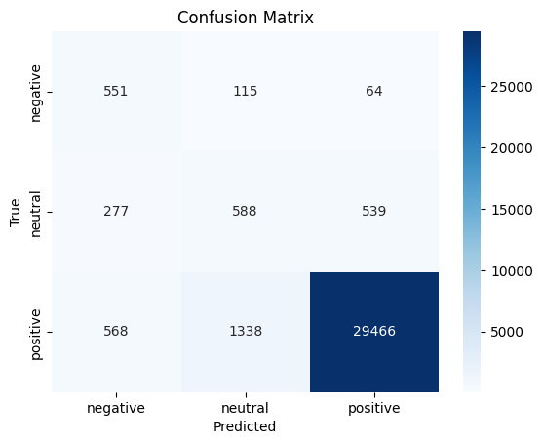
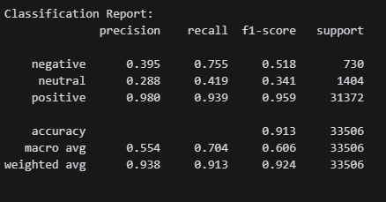
Tokenization
Metrics and Results:

Slide 24
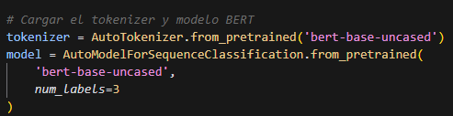
Fine-Tuning Sentiment
The dataset used: 1429_1.csv
from https://www.kaggle.com/datasets/datafiniti/consumer-reviews-of-amazon-products
The model used: Bert-base-uncased

Slide 25
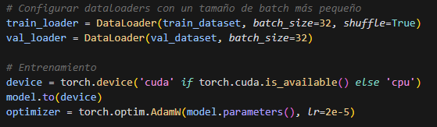
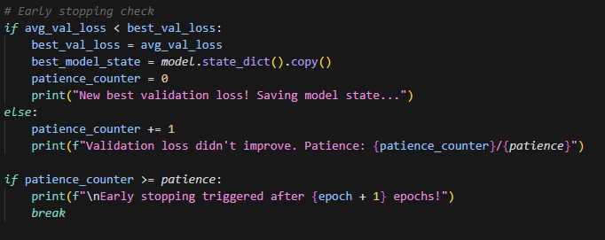
Parameters
BATCH_SIZE = 32
EPOCHS = 10s
Learning rate = 2e-5
Early Stopping patience = 3

Slide 26
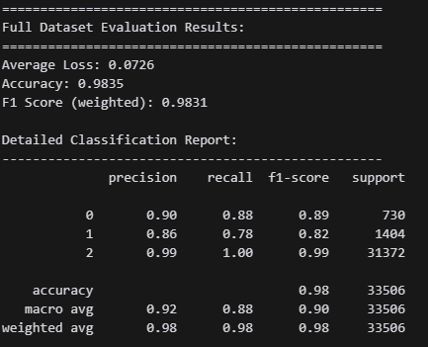
Metrics

Slide 27
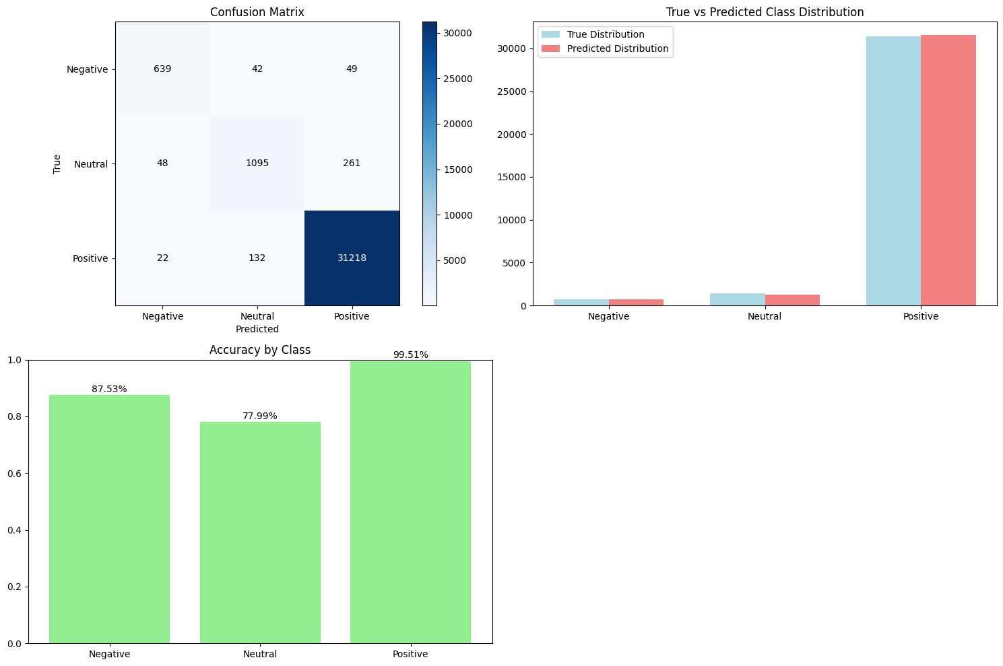
Metrics

